Slide 1
Repose and Colorize Black-n-White photos
Priyanshu Singh, 170101049
Keerti Harpavat, 170101031
Aman Mishra, 170101005
Project Repo

Slide 2
01
INTRODUCTION

Slide 3
AIM
Our aim is to take any random posed black-n-white image and convert it into a colored passport posed photograph.
This will be helpful in generating colored images of the historic people which can be used for various purposes like on stamps as well as bringing colors to the old family photos.
We have developed a small website which takes any input image and converts it into a colored passport image, saving one from the fine details of the working model.

Slide 4
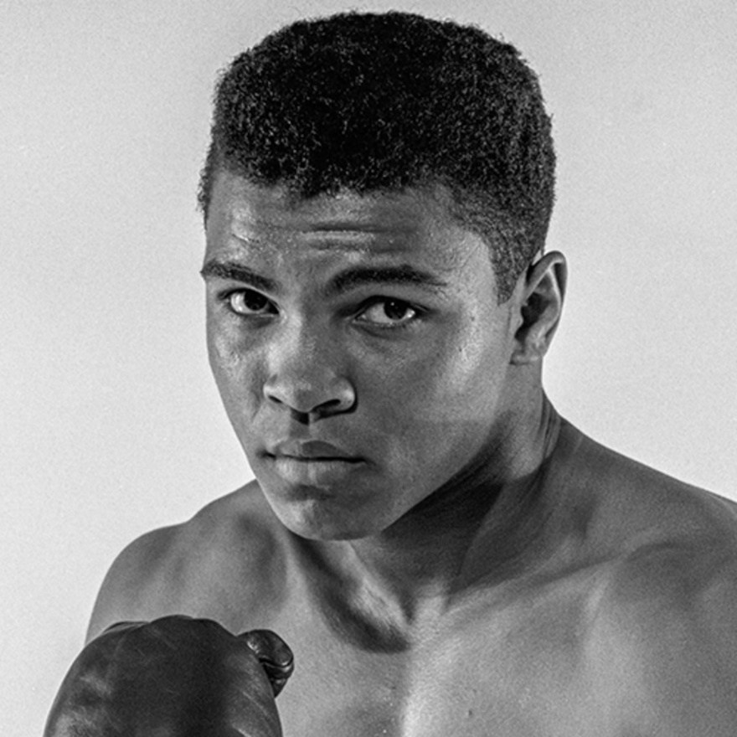
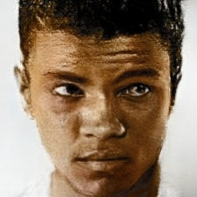
Output
Input

Slide 5
02
WORK FLOW

Slide 6
KEY IMPLEMENTATION STEPS
First step would be to take the random posed image, make a 3D fitting face model of that image and rotate it such that the person in the image is front facing.
Next step would be to colorize the image. For this, we use a deep Convolutional Neural Network.
We have also added a further improvement to the colorization. We take the ethnicity of the person in image as input and change the skin color of the image according to ethnicity.
We have also thought of an ingenious way to improve the colorization. For this, we have prepared a dataset that contains over 2300 image pairs of colored and grayscale images from which we fine-tuned an existing Res-net model to accomplish this task.

Slide 7
03
FACE FITTING AND REPOSE
Rotate-and-Render: Unsupervised Photorealistic Face Rotation from Single-View Images

Slide 8
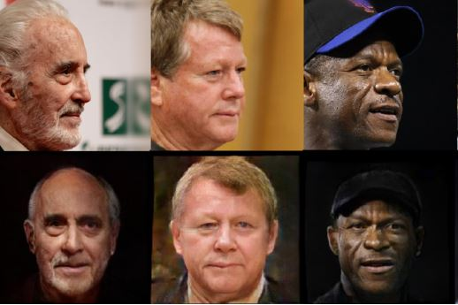
INTRODUCTION
Our objective is to take an image of a single person and change the pose of the person in that image.
This whole process of reposing can be broken down into 3 sub-tasks:-
3D Face Fitting
Rotate-and-Render for training data preparation
Render-to-image Translation module

Slide 9
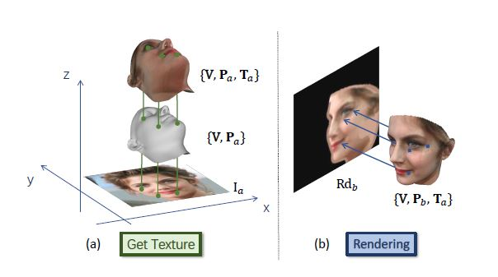
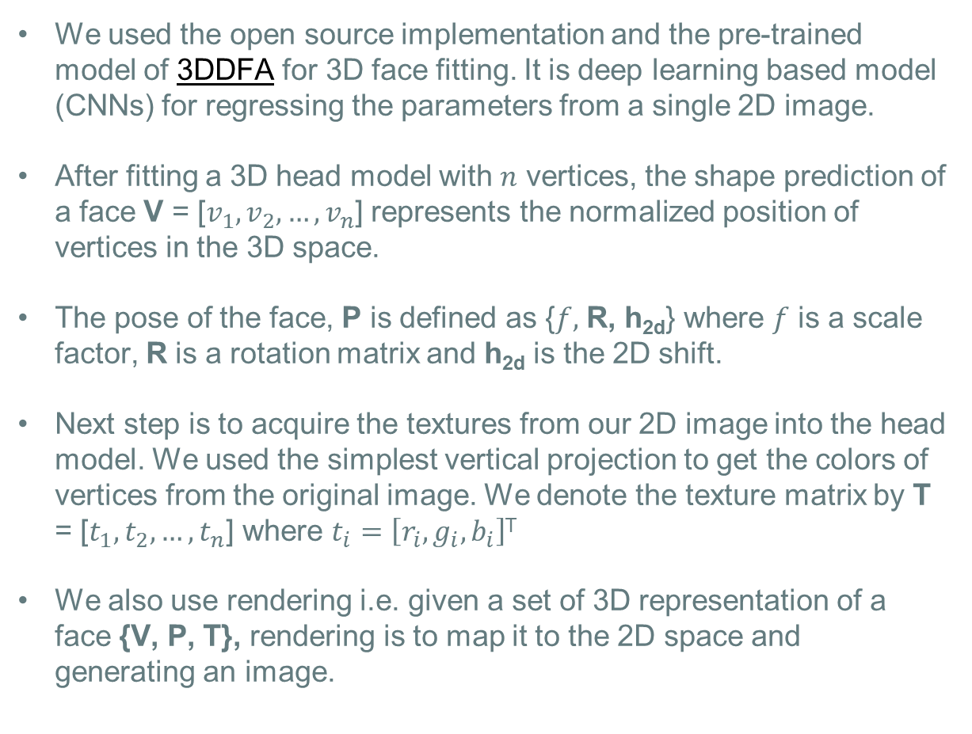
3D FACE FITTING
We used the open source implementation and the pre-trained model of 3DDFA for 3D face fitting. It is deep learning based model (CNNs) for regressing the parameters from a single 2D image.
After fitting a 3D head model with $n$ vertices, the shape prediction of a face V = [$v_{1}, v_{2}, …, v_{n}$] represents the normalized position of vertices in the 3D space.
The pose of the face, P is defined as {$f,$ R, h_{2d}} where $f$ is a scale factor, R is a rotation matrix and h_{2d} is the 2D shift.
Next step is to acquire the textures from our 2D image into the head model. We used the simplest vertical projection to get the colors of vertices from the original image. We denote the texture matrix by T = [$t_{1}, t_{2}, …, t_{n}$] where $t_{i}=\left[r_{i}, g_{i}, b_{i}\right]$^{T}
We also use rendering i.e. given a set of 3D representation of a face {V, P, T}, rendering is to map it to the 2D space and generating an image.

Slide 10
ROTATE AND RENDER
While reposing the images, the final images may contain artifacts which needs to removed.
Previous approaches to repose images used Neural Networks trained on paired data. Because we don’t have the paired data, we devise a way to generate the paired data from a single image (Unsupervised method).
Steps to generate the paired data :-
1. Given a pose P_{a} , rotate its 3D mesh randomly to create another pose P_{b} and render it to the 2D space to get a 2D rendered image Rd_{b}
2. Rotate this Rd_{b} back to the original position and render it to be Rd_{a’} using the textures from Rd_{b}
3. So, we get the new image Rd_{a’} which contains artifacts due to rotation and our original image. This is a paired data which will be used by GANs and VGGs used in next step to make a mapping.

Slide 11
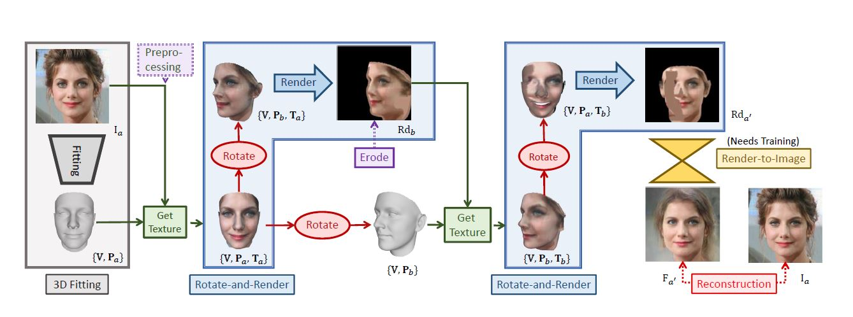
ROTATE AND RENDER

Slide 12
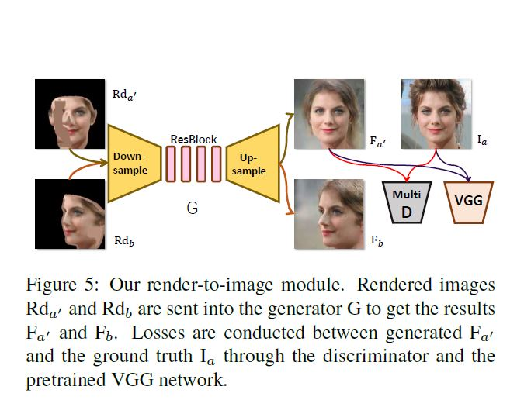
RENDER-TO-IMAGE
In order to eliminate the artifacts and map the rendered image Rd_{b} and Rd_{a’} from the rendered domain to real image domain, our next step is to use a render-to-image generation module to create F_{a’} = G(Rd_{a}’) and F_{b} = G(Rd_{b}) using generator G which is adopted from Cyclic GAN.

Slide 13
04
DEEP COLORIZATION
Real-Time Image Colorization with Learned Deep Priors

Slide 14
DEEP COLORIZATION
We used a pre-trained deep CNN network that automatically colors an input image according to the mapping learnt from the training set.
One drawback that we inferred from the output images using this methods was that this network was trained on very generic images and not exclusively on human faces, so the automatic results from the input image were not that satisfactory in terms of skin color.
To improve on this, we have built our own custom skin color changing module that first detects the skin from the image and then colors it according to the user input.

Slide 15
05
CHANGING SKIN COLOR

Slide 16
CHANGING SKIN COLOR
We first extract the face of the image from the input image using OpenCV’s Haar Cascade Frontal Face Classifier.
To obtain skin color, we apply k-means clustering algorithm to obtain the most dominant color from the face detected in the image.
Using this color, we search on the full image for pixel values that are close to the skin color obtained for face. We assume whenever a pixel in image matches the skin color, it is the skin.
After we obtain the skin, we take the original skin color and create a function that maps this original color to the color that we want.
Now, we overlap this skin color on the previously found out skin region and we have our final resultant image.

Slide 17
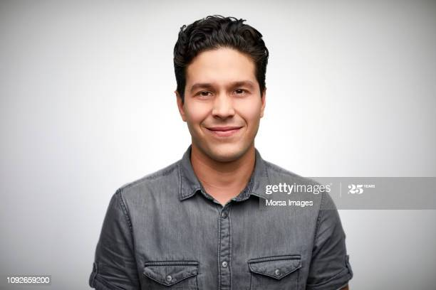
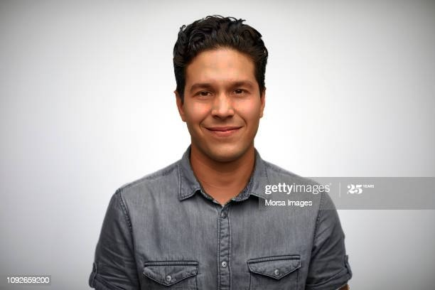
EXAMPLE
Original Image
Skin Color Changed

Slide 18
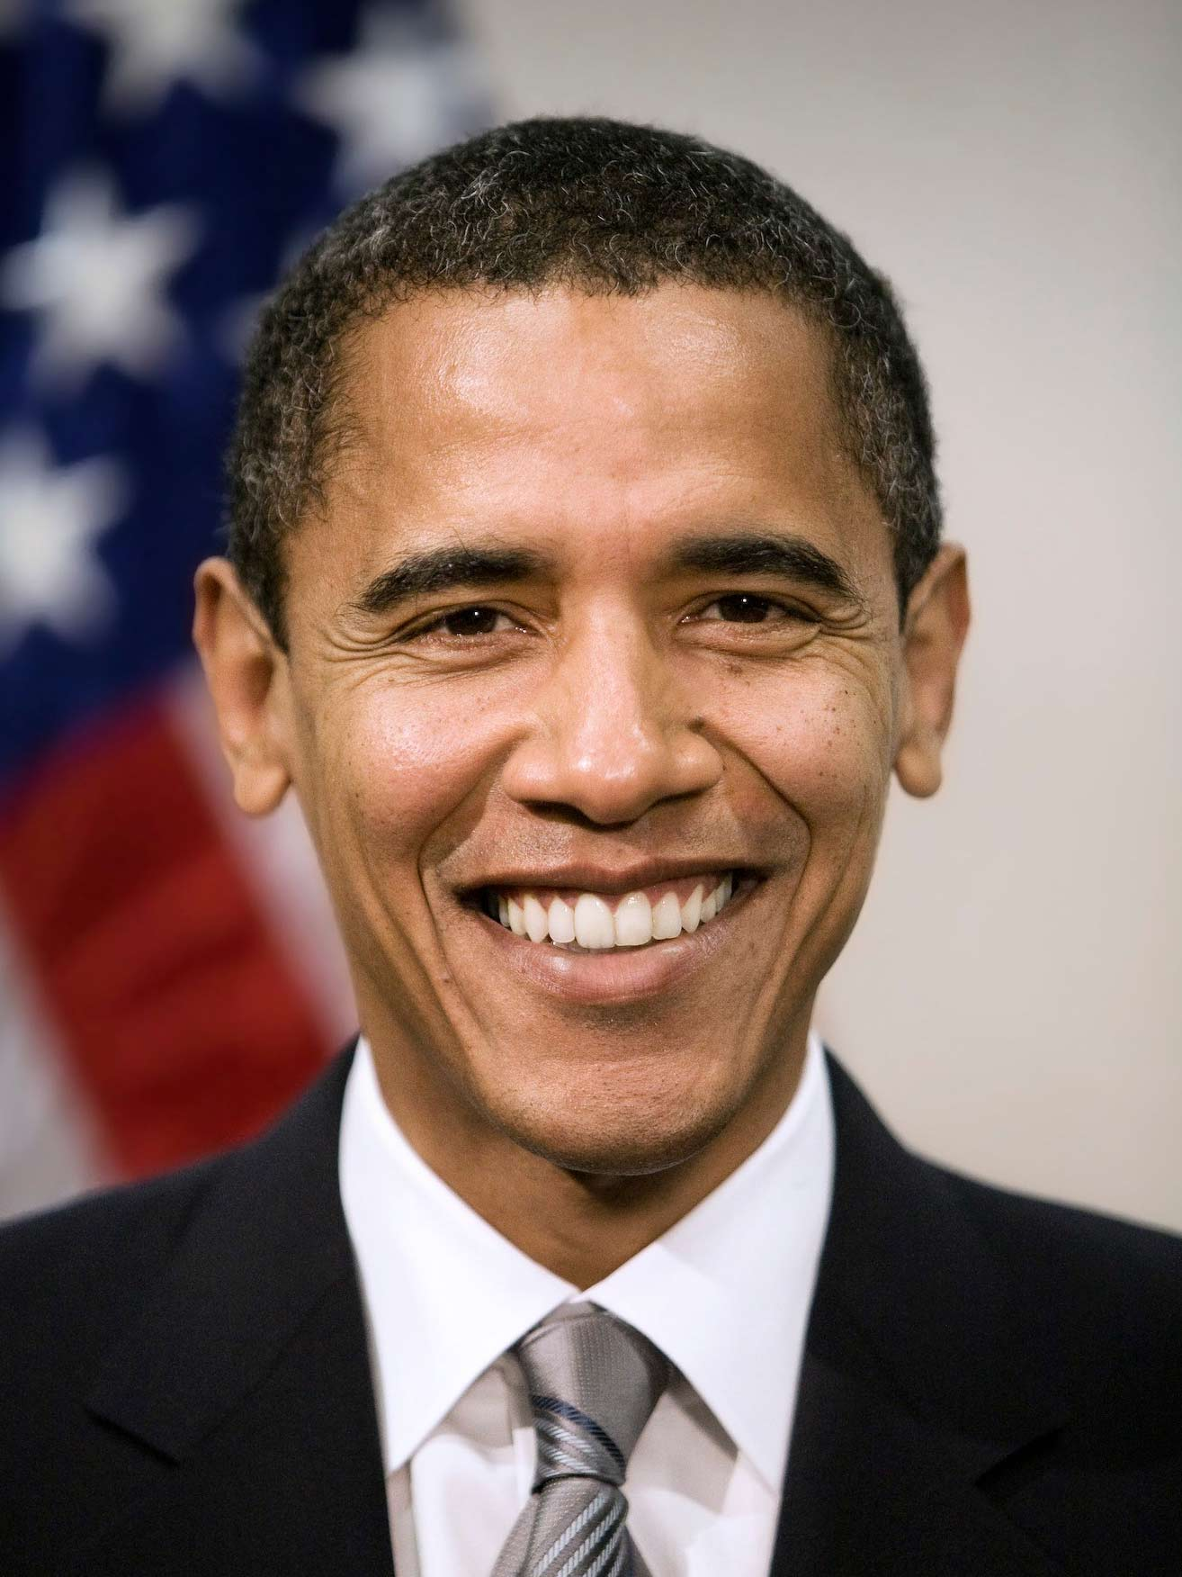
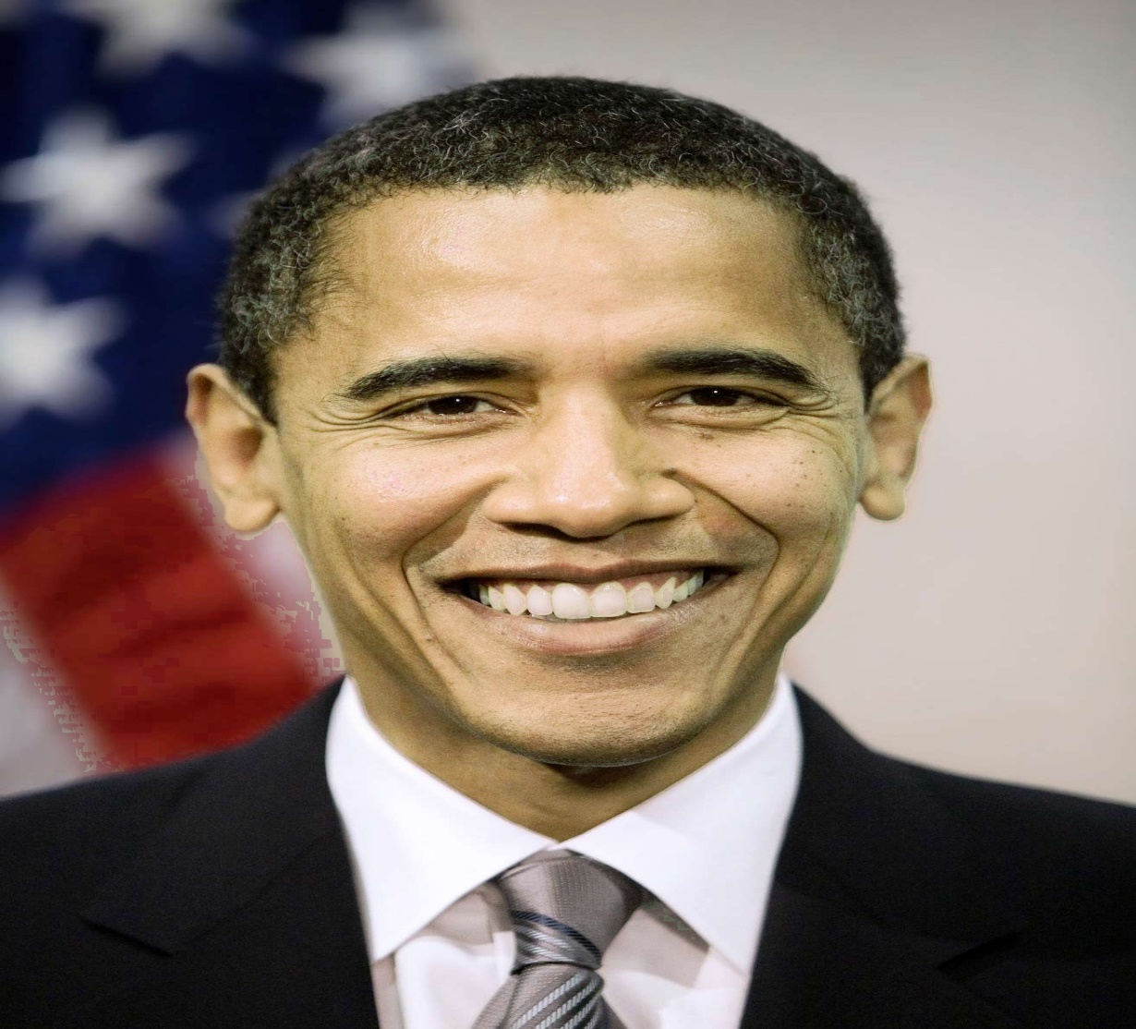
EXAMPLE
Original Image
Skin Color Changed

Slide 19
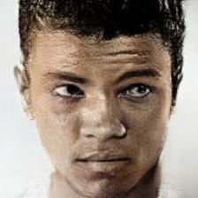
IMPROVEMENT
Default Colorization
Custom Colorization
Original Image

Slide 20
06
COMPLETE PIPELINE

Slide 21
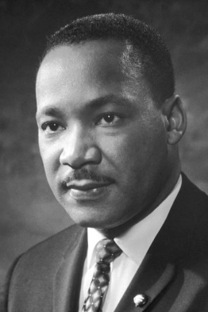
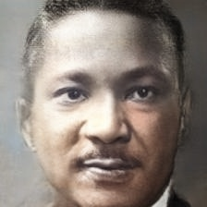
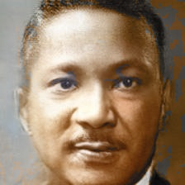
EXAMPLE
Default Colorization
Custom Colorization
Original Image

Slide 22
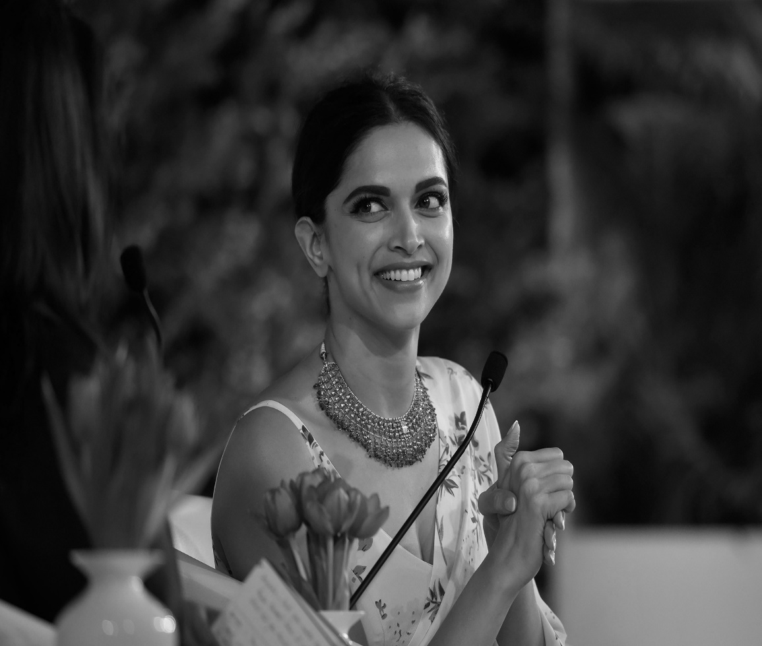
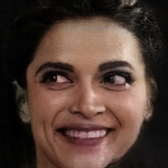
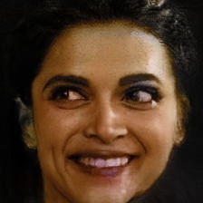
EXAMPLE
Default Colorization
Custom Colorization
Original Image

Slide 23
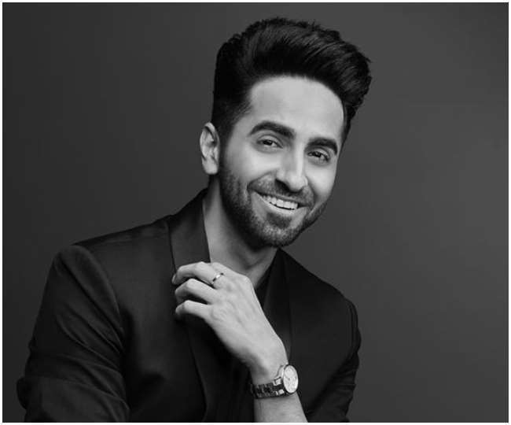
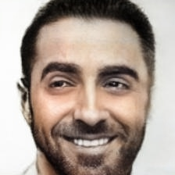
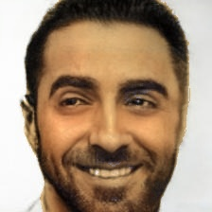
EXAMPLE
Default Colorization
Custom Colorization
Original Image

Slide 24
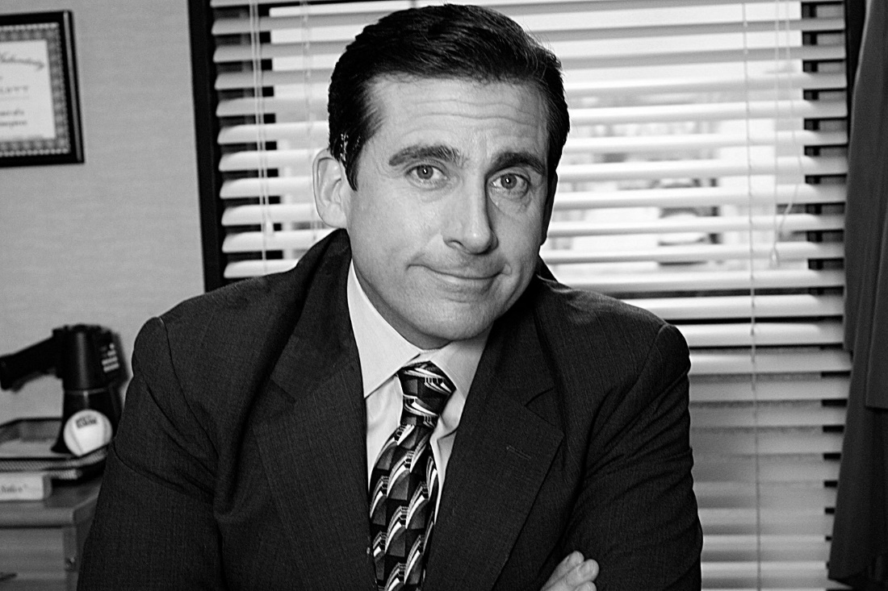
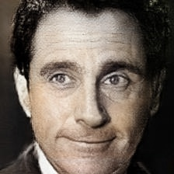
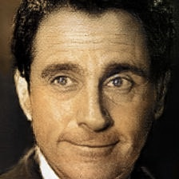
EXAMPLE
Default Colorization
Custom Colorization
Original Image

Slide 25
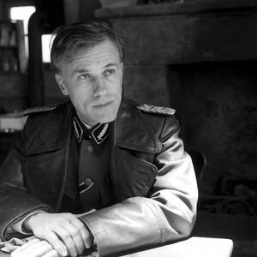
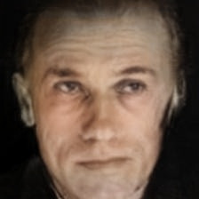
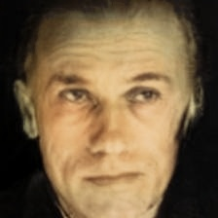
EXAMPLE
Default Colorization
Custom Colorization
Original Image

Slide 26
07
LIVE DEMO

Slide 27
CHALLENGES
The implementation of face rotation part was outdated and was not compatible with the latest frameworks. We fixed a lot of issues in their repo and got the code working end-to-end.
Finding the skin color from the image was a challenging task. We had to ensure that we were not taking some other parts of image that were not skin.
The RGB values of various ethnic groups does not work with all the images. So, to make our pipeline fully automatic, we fine-tuned the Res-Net network with only images containing portrait photos.
We were only able to train around 2300 image pairs for 300 epochs which took around 2 days. We weren’t able to train it for longer time because we didn’t have GPU resources, so we used Google Colab, but it only provides single GPU for limited time and have only limited RAM and disk size.
Debugging the training code for this network was a tedious task because of suboptimal output which couldn’t be attributed to buggy code or due to lack of training data.
The implementation of models in the backend of website to show end-to-end results took some time as we were not familiar with the tools.

Slide 28
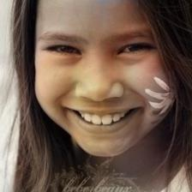
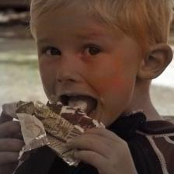
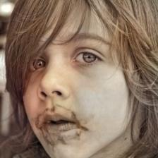
PRELIMINARY RESULTS
Project Code

Slide 29
LIMITATIONS
Rotate and Render module does not produce good results when we have very side facing subject in the image. The reposed image in this case contains artifacts and the textures on the image are not consistent.
This leads to bad coloring on the image, with skin-color spilling even outside the image.
Automatic coloring that uses deep-CNN is not very robust to color faces as it was trained on general images. This results in less accurate coloring in some photos, specially the ones involving fuzzy boundaries.
Skin-color changing module is not very robust. Sometimes, it picks up skin in regions of image where there is no skin. This happens in cases where image background color properties are very similar to the skin color.
Some part of this system is currently manual. We have taken some steps to remove that.

Slide 30
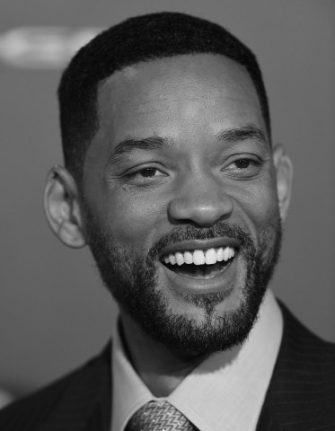
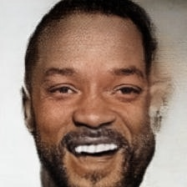
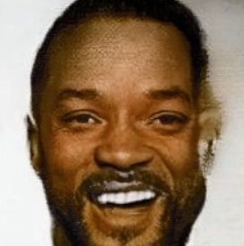
FAILURE CASE
Default Colorization
Custom Colorization
Original Image

Slide 31
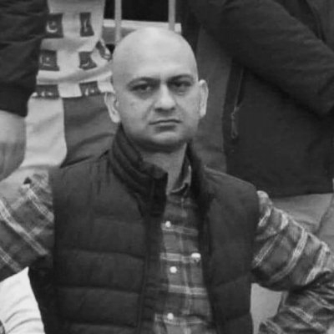
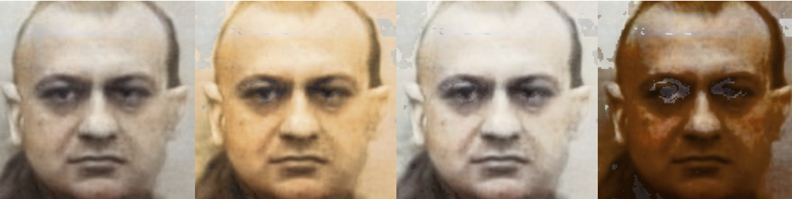
FAILURE CASE
Original Image

Slide 32
ORIGINAL CONTRIBUTIONS
Contributed to fixing issues in the Rotate and Render code module and used the changes for our own working implementation.
Wrote the complete skin-color changing module from scratch taking ideas from various articles and stack overflow.
Built the website using flask framework for complete demonstration of end-to-end working of all the code parts.
Prepared the dataset consisting of 2300+ image pairs(grayscale and colored) for training purposes in the Res-Net network.
Wrote the complete training code for training the prepared dataset on the Res-Net network.
Ongoing:- Getting more face images for expanding our dataset (currently thinking of including Celeb-A dataset). This would result in our dataset being substantially big to produce the desired outputs.

Slide 33
THANKS

